Slide 1

MINI PROJECT -1
AWS

Slide 2

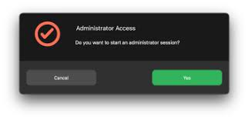
LAB-1(I AM HAND-ON)
Set MFA to root user.
Create an user and give only EC2 access
Than create EC2 instance along with
with this create other services.
EC2 ✅ S3❌
Provide full permission.
All services ✅

Slide 3

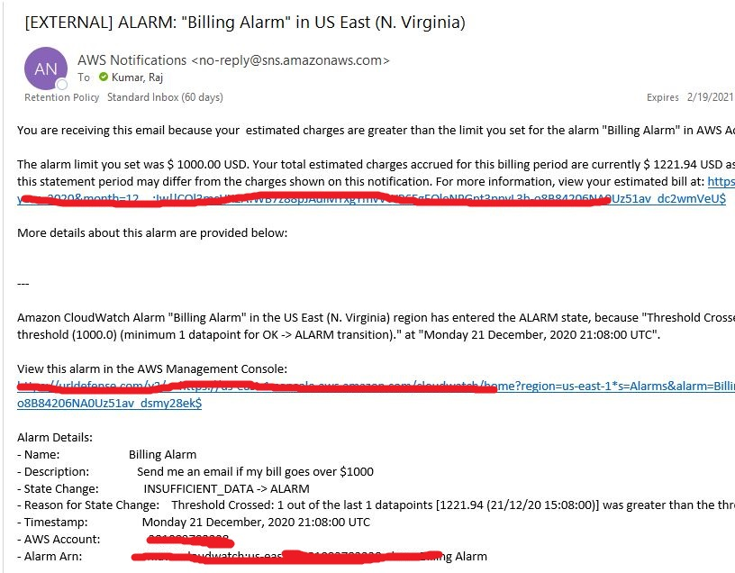
LAB-2(Billing Alarm)
Cloud watch service.
Set the threshold billing amount.
Through the SNS service we get notification.

Slide 4
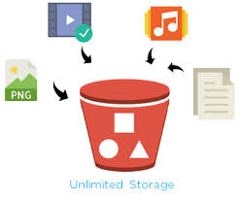
LAB-3(S3 bucket)
Amazon S3 to store and retrieve any
amount of data at any time,from anywhere.
We can access anywhere by providing some rules/policies and enabling versions and changing the access control list.etc
It will act as a backup when we enable the versioning if we suddenly delete the files.
When we update the file which is existing the result will be the updated one.

Slide 5

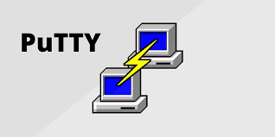
LAB-4(EC2 instance)
Amazon EC2(Elastic compute cloud)
a virtual server in AWS terminology.
Launching the ec2 instance with
the ubuntu.
Connect the server using the
putty software.

Slide 6
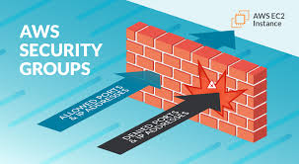
LAB-5(Security Groups)
Provide an efficient way to assign access to resource on your network.
Create a SG and edit the inbound rules or provide the port 80 and 22 from our IP address by selecting a range IP/28.
It will not access the server
When we provide the SSH or default SG than it connected.

Slide 7
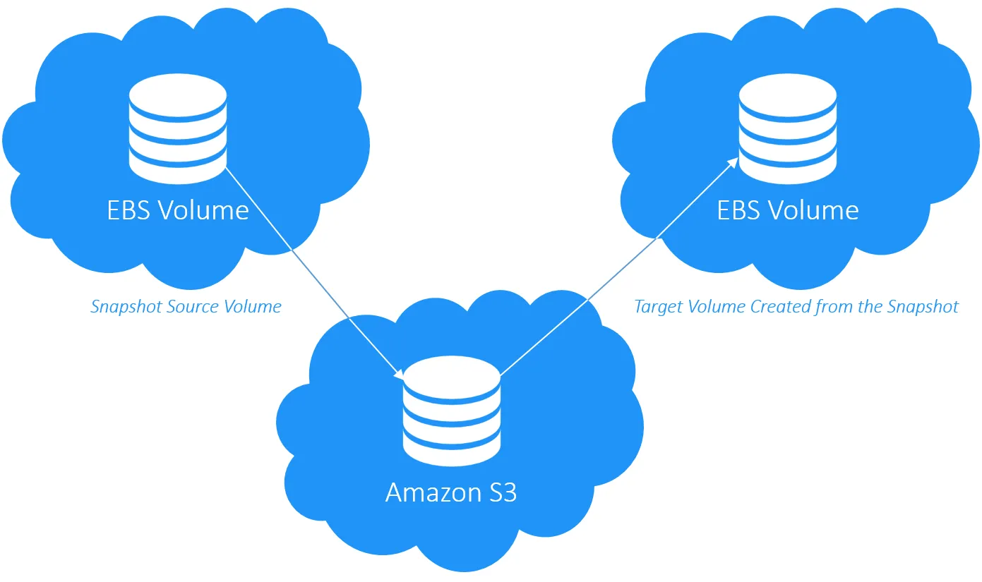

LAB-6(Volumes and snapshots)
Create the instance and create the volume with 5gb.
Attach the volume to the instance and connect the server.
Available volume in the instance and add some files in
that by create a directory and file.
Than mount that file by using some commands.
It will store in that volume and increase the volume size
and than agaim mount the volume in the terminal.
Create the snapshot for that volume and delete the volume.
We can get the same volume by the snapshot
Backup .

Slide 8



LAB-7(AMI-Amazon Machine Image)
AMI is a templete that contains a software configuration
(OS,Application servers,etc) used to create a virtual machine within
the Amazon EC2 environment.

Slide 9
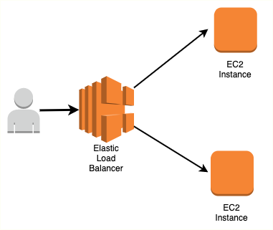
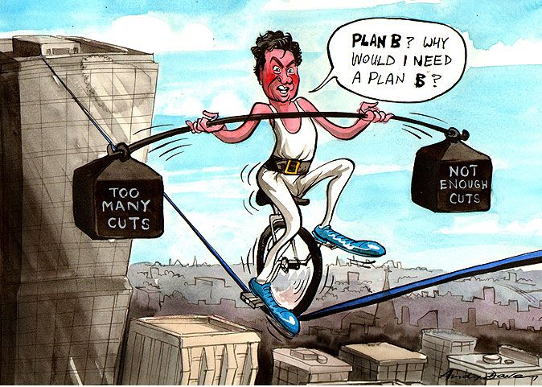
LAB-8(Load balancer)
It serves as the single point of contact
for clients.
Manage the load from the incoming application
traffic to multiple targets applications.
Use LB will increase the availability of application
and decrease the workload.

Slide 10
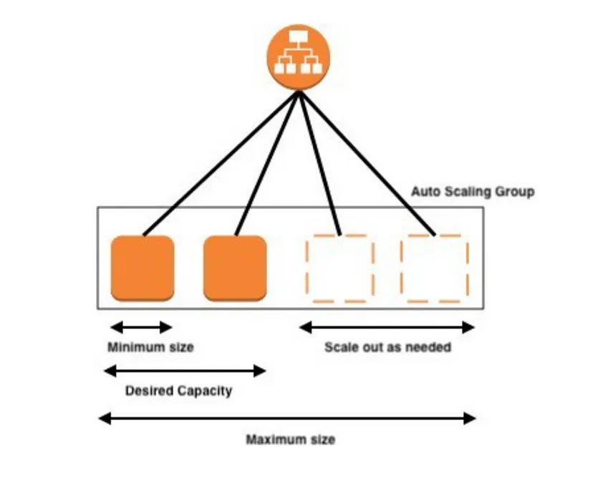
LAB-9(ASG & LT)
Auto scaling group is the service which
helps to adjust the number of instances
based on the demand.
LT templates to automate instance,simplify
permissions enforce best practices across
your organization.
Here I have created a LT and ASG,than attached both.
Set the min and max capacity of instances and desired
capacity than observe and later increase the max cap and observe
the instances.

Slide 11
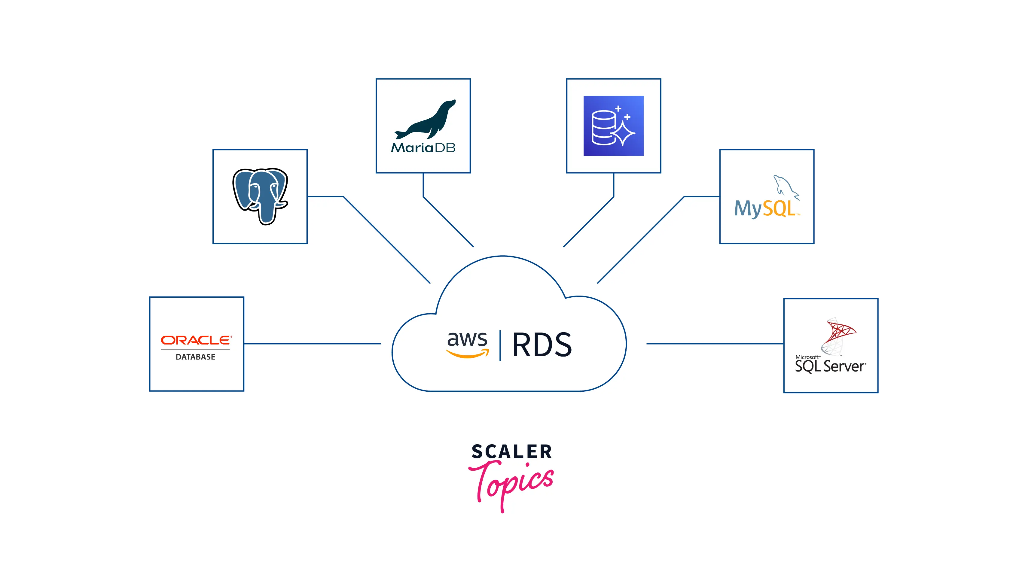
LAB-10(RDS-Relational Database Service)
Amazon Relational Database Service (RDS) is a managed database service that makes it easier to set up, operate, and scale relational databases in the AWS Cloud.
Choose MySQL and provide the master username and password.
Create database and instance than provide Mysql/auroura in SG
than connect to the server.
Later install the mysql and connect it.

Slide 12


